Slide 1

BDA102 Assignment 4 – Sentiment Analysis on the Implementation of Marijuana Legalization in Canada
Team 2
Jason Baker
Monique Ardizzi
Meera Ragunathan
Jeff Ciraolo
Jonathan Bungcayao

Slide 2
What is your Project?
We are a Concerned Citizens Think Tank with the goal of insuring that the government is implementing the legalization of marijuana in Canada in accordance with what the people want. We would like to understand the level of support for the bill that passed recently and what concerns are arising from the people if any. Our hypothesis was that there would be a large amount of positive support towards the bill.
We analyzed a series of tweets related to marijuana legalization in Canada to build a classifier for sentiment analysis and applied it on a broader set of related tweets.

Slide 3
How did you build your algorithm?
Data Gathering
Sample of tweet text extracted for the first 3 weeks of June
Hashtags used to find relevant tweets: #CannabisAct, #BillC45, #C45, #Legalization, #CannabisinCanada, #C46, #marijuananews, #marijuana, #cannabis, #MarijuanaDecriminalization, #blessthiscountry, #LegaliseCannabis
Data Cleaning
Tokenize tweets, removes non-alpha words, <3 letter words, stop words
Data Modelling
Labelled a training dataset of 500 tweets with positive, negative, or neutral sentiment
Naïve Bayes classifier model built on training dataset
Validation of model against a test dataset of 100 labeled tweets
Model then applied on new unlabeled data

Slide 4
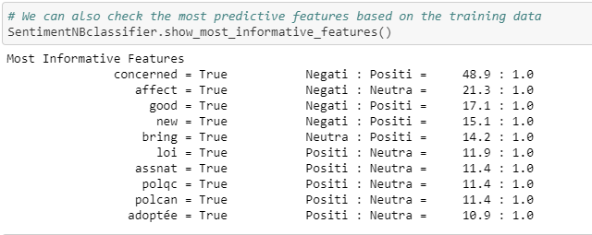
Explain your algorithm
We selected a Naïve Bayes algorithm for our model from the NLTK library in Python
Based on the training data, calculates many conditional probabilities that a tweet is positive, negative, or netural given the features present
Feature extraction function: checks if tweet contains vocabulary word, for all words in the training vocabulary
Algorithm showed 79% accuracy on the testing data
Fast algorithm that performs quite well for sentiment analysis, especially given a robust training dataset
Relatively easy to explain in a business setting

Slide 5
Difficulties and challenges while building
Twitter data mining challenging due to limited client capability (non-enterprise client)
Only had last 7 days of data
Only 100 tweets per pull
Collaboration, coordinating of schedules, time constraints
Eventually, decided on using git repo to overcome this
Some tweets not in English, funky characters, etc.
Labelling of hundreds of tweets for training dataset quite time consuming

Slide 6
Insights
Change, pleased, attitudes, positively, great, everyone
Recreational, canborder, regulated
Concerned, construction, bad, jodieemery, attacks, charter

Slide 7
Key takeaways
Majority of sentiment is positive
Within the negative sentiment subset, many concerns arising around
Safety in the workplace (specifically construction industry)
Government extending even more control over the people
Bill introducing even more criminal offences
More so than we had anticipated, negative tweets coming from marijuana advocates who are not happy with implementation
Lots of coverage from news outlets—neutral segment mainly consisting of news

Slide 8
What more can you apply to improve your model (accuracy or better insights)?
Larger, more robust training dataset and samples to apply model on
Deeper cleaning of data
N-gram analysis to derive insights on the sentiment classes rather than simple bag of words analysis
Get demographic/geographic information about the individual tweeting so that we can gain insights by age, geography, urban/rural, occupation, socioeconomic class, etc.

